Slide 1
Chapter 6 Arithmetic Unit

Slide 2
Contents:
Representation of Binary number and Arithmetic in Unsigned Notation
Addition and Subtraction in Unsigned Notation
Multiplication in Unsigned Notation, Shift Add Multiplication Algorithm, Booth’s Algorithm
Division in Unsigned Notation, Shift Subtract Division Algorithm
Signed Notation
Addition and Subtraction in Signed Notation
Binary Coded Decimal (BCD), BCD Numeric format, BCD Addition
Specialized Arithmetic Hardware: Lookup ROM, Wallace Tree, Arithmetic Pipeline
Floating Point Numbers, Numeric Format
IEEE 754 Floating Point Standard, numeric Format

Slide 3
6.1 Arithmetic Unit
The Arithmetic unit is a part of processor that executes arithmetic operations.
A microprocessor is capable of processing numeric data in one or more formats.

Slide 4
Data Representation
Data representation should require three provisions:
Provision for +ve number(or Unsigned number) representation
Provision for –ve number (or signed number) representation.
Provision for fractional number representation.

Slide 5
Representation of Binary number and Arithmetic in signed Notation

Slide 6
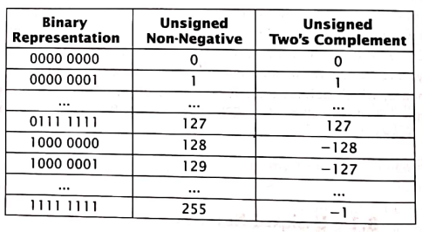
a) Unsigned Number Representation
In unsigned notation, there is no any separate bit to represent the sign (Positive or Negative) of the number.
Eg:
1111
This is equivalent to 15 in decimal value.

Slide 7
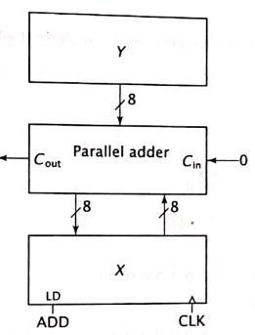
i) Addition in Unsigned Notation
For both the non-negative and two’s complement notations, addition and subtraction are fairly straightforward.
Addition is implemented as a straight binary addition.
It is realized in hardware by using a parallel adder as shown in the figure.
Here, X and Y are 8-bit registers.
The circuit performs the micro-operation
ADD: X← X+Y.

Slide 8
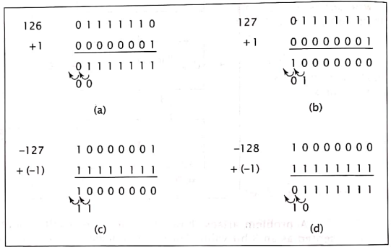
Overflow during Addition in Unsigned Notation
Overflow only occurs when two numbers with the same sign are added.
Adding two numbers with different signs always produce a valid result.
Subtraction can be converted to addition and performed in a similar manner.

Slide 9
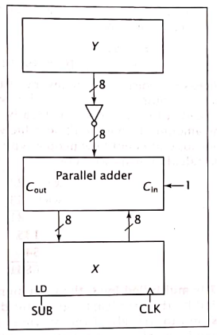
ii) Subtraction in Unsigned Notation
Subtracting numbers in two’s complement notation is also implemented as X-Y = X+(-Y).

Slide 10
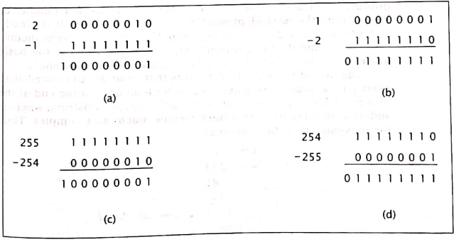
Overflow during Subtraction in Unsigned Notation

Slide 11
b) Signed Number Representation
There are three ways to represent –ve numbers.
Signed Magnitude Representation
1’s Complement Representation
2’s Complement Representation

Slide 12
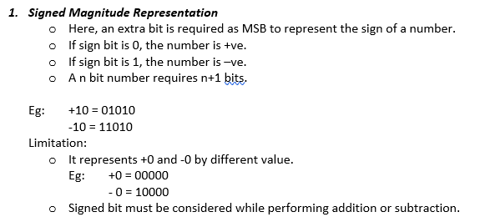

Slide 13
2) One’s Complement Representation
Here, negative numbers are represented by complementing each bit.
Eg: +6 = 0110
- 6 = 1001
Limitation: It represents +0 and -0 by different value.
Eg:
+0 = 0000
-0 = 1111

Slide 14
3) Two’s Complement Representation
Two’s complement representation overcomes the fore-mentioned limitation.
Two’s complement = One’s complement + 1
Eg:
+6 = 0110
-6 = 2’s complement of 0110 = 1001+1 = 1010

Slide 15
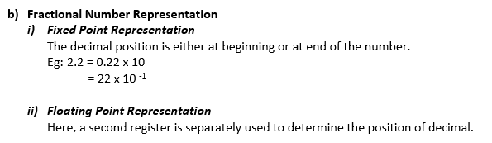

Slide 16
Addition and Subtraction in signed Notation

Slide 17
6.3 Multiplication Algorithm
Unsigned Multiplication
Shift-Add Algorithm
Signed Multiplication
Booth’s Algorithm

Slide 18
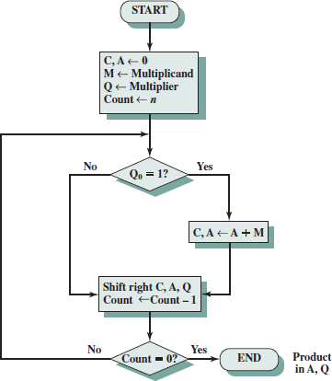
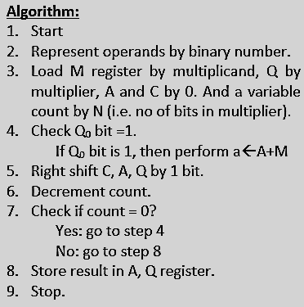
Unsigned Multiplication
Let us consider:
M=Multiplicand
Q= Multiplier
A= Result stored register
C= 1 bit register for carry
This is just for reference.
Do not follow this

Slide 19

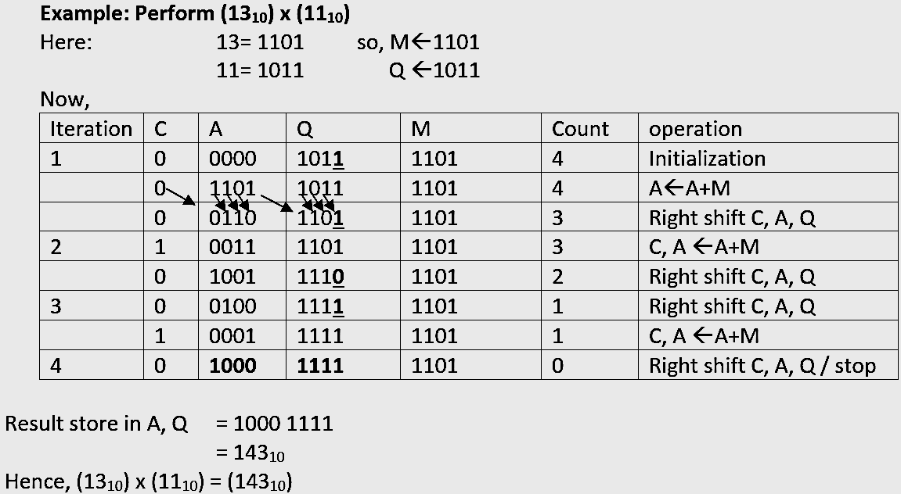
1
,Count--
, Count--
,Count--
4
This is just for reference.
Do not follow this

Slide 20
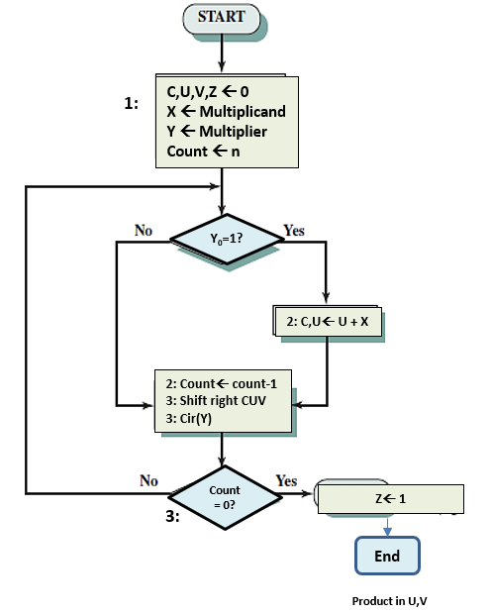
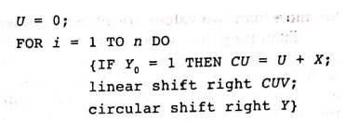
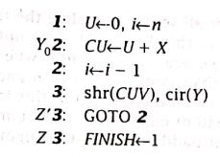
a) Shift Add Algorithm for Unsigned Multiplication
Algorithm
RTL Code

Slide 21
1:
C,U,V,Z ← 0
X ← Multiplicand
Y ← Multiplier
Count ← n
Y₀=1?
2: C,U← U + X
2: Count← count-1
3: Shift right CUV
3: Cir(Y)
Count= 0?
Z← 1
3:
End
Product in U,V

Slide 22
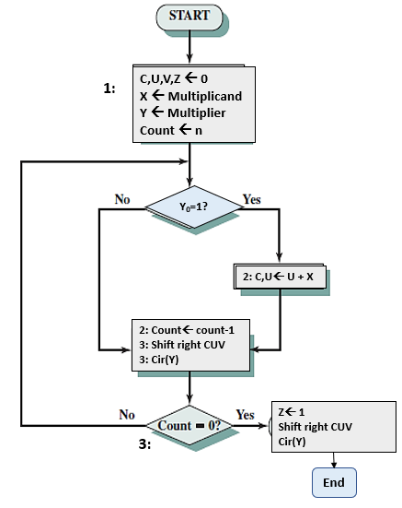
Product in U,V

Slide 23
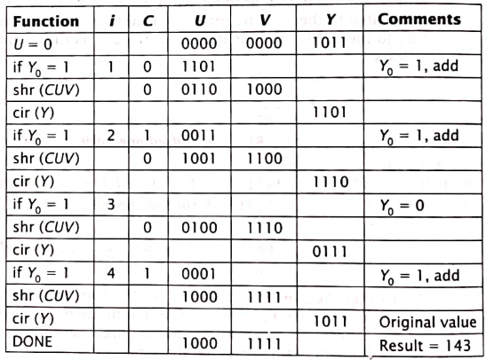
Multiplication of 13 x11
Initially X=1101 and Y=1011

Slide 24
RTL code to realize Add-shift Algorithm
The RTL code to realize this algorithm, with these changes, is as follows.
Note that Z=1 when i=0 and 1,2 and are consecutive states, that is, the algorithm goes from 1 to 2 to 3.

Slide 25
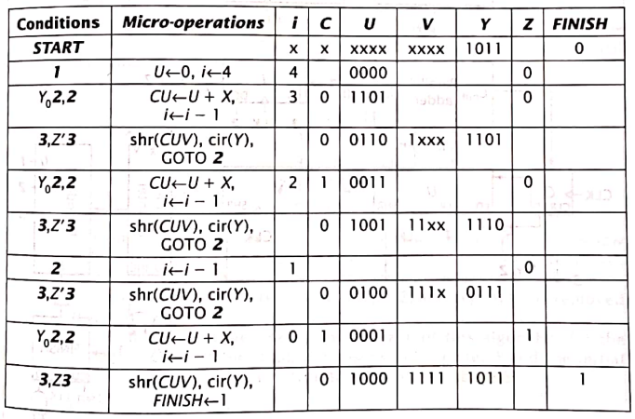
RTL code for Unsigned Multiplication for 13 x11
Again X=1101 and Y=1011
It is same as the trace of above table,
Except it shows the condition met and micro-operations performed during every cycle.

Slide 26
RTL code for Unsigned Multiplication for 13 x11

Slide 27
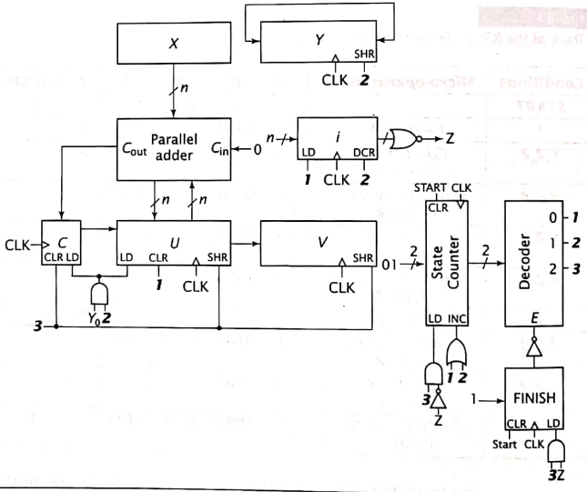
Hardware Implementation of Shift-Add Multiplication Algorithm
3

Slide 28
Classwork:
1. Perform: 10₁₀ x 12₁₀ = ?

Slide 29
b) Signed Multiplication
It is also called Booth’s algorithm or Two’s complement multiplication.
Here, negative numbers are represented by 2’s complement representation.

Slide 30
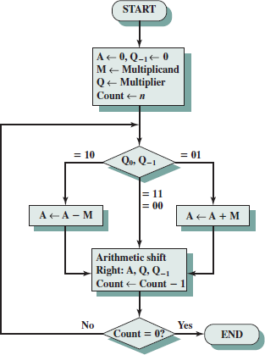
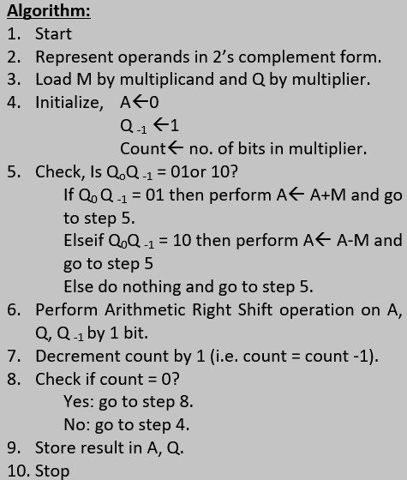
Suppose:
M= multiplicand
Q=multiplier
A,Q= result stored register
Q ₋₁ = 1 bit register which is adjusted after Q₀.
This is just for reference.
Do not follow this

Slide 31
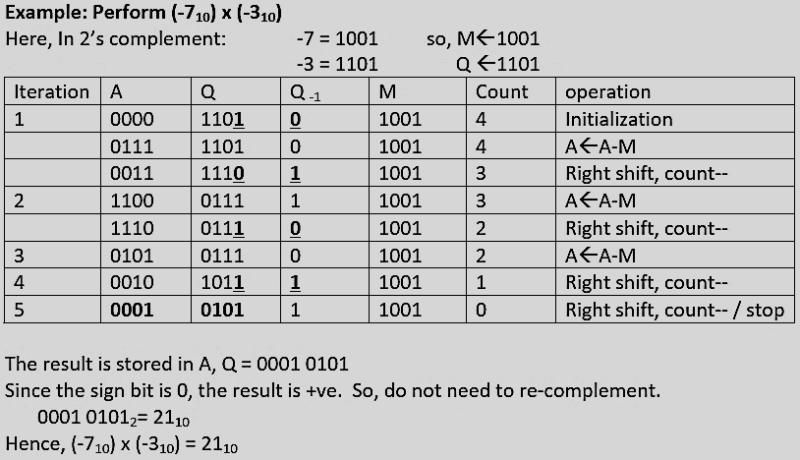
1
This is just for reference.
Do not follow this

Slide 32
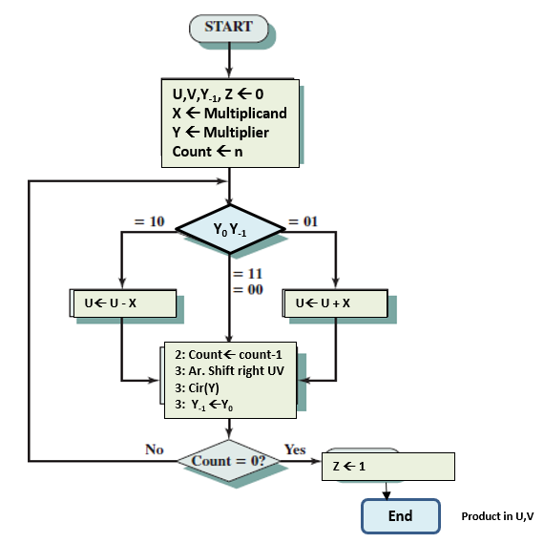
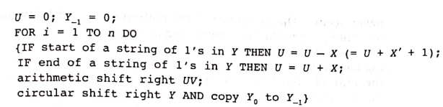
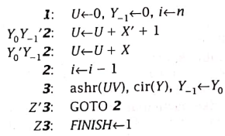
b) Booth’s Algorithm for Signed Multiplication
Algorithm
RTL Code
U= 0; Y-1=0;
FOR i=1 to n DO
{
IF Y₀Y₋₁= 01, THEN U=U+X
ELSE IF Y₀Y₋₁ = 10, THEN U=U+X
Arithmetic Shift Right CUV;
Circular Right Shift Y;
Y₋₁-=Y0;
}

Slide 33
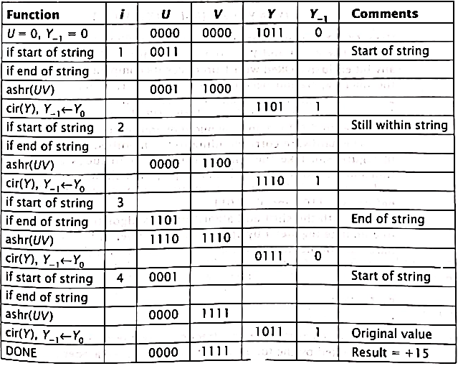
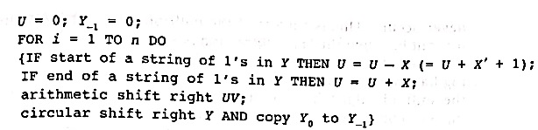
Multiplication of -3 x-5 using Booth’s Algorithm
Initially X=1101 and Y=1011
U=0000
V=0000
Y₋₁= 0

Slide 34
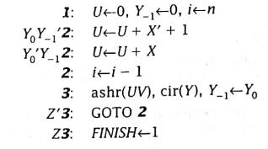
RTL code to realize Booth’s Algorithm
The RTL code to realize this algorithm, with these changes, is as follows.
U,V, X and Y are n-bit values and Y-1 is a 1-bit value
i counts down from n to 0.

Slide 35
U,V,Y₋₁, Z ← 0
X ← Multiplicand
Y ← Multiplier
Count ← n
Y₀ Y₋₁
U← U - X
U← U + X
2: Count← count-1
3: Ar. Shift right UV
3: Cir(Y)
3: Y₋₁ ←Y₀
Z ← 1
End
Product in U,V

Slide 36
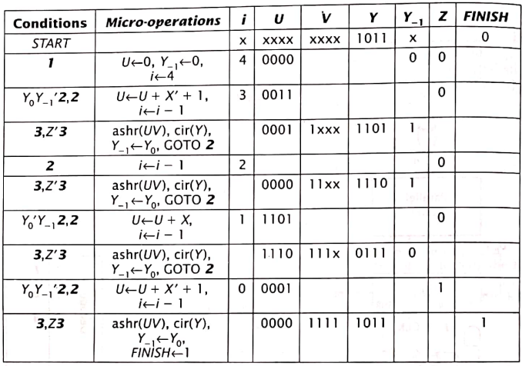
RTL code for Booth’s Algorithm for -3 x -5
Note:
If you get 1 at MSB of U, then your result is negative. So, you need to re-complement it to verify your answer.

Slide 37
Reminder Note:
If you are are given -13 and -4 to be multiplied.
First find 2's complement of each negative numbers.
Eg: -13= 2's complement of 1101 = 0010+1= 0011
Then take one more extra bit for sign.
ie. -13 = 10011
Similarly, -4 =2's complement of 00100 = 11011+1= 11100
However, for multiplication of -7 and -5, only 3 bits are enough to represent each of them. So, we can be take only 4 bits for each.
Alert! If you do not take 1 extra bit, your calculation will be considered totally wrong.

Slide 38
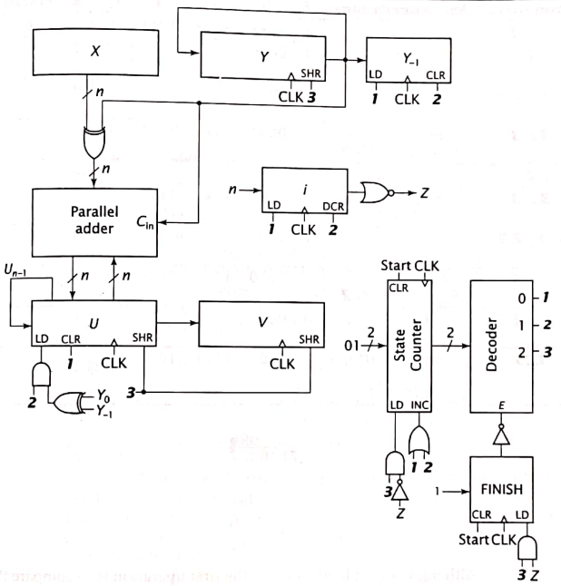
Hardware Implementation of Booth’s Algorithm
3
1

Slide 39
Classwork:
Multiply 4 x -8 using Booth’s Algorithm.
Perform: 7₁₀ x -3₁₀ =?
Perform: 9₁₀ x -3₁₀ =?
[Hint: Take 5 bits for both X and Y]

Slide 40
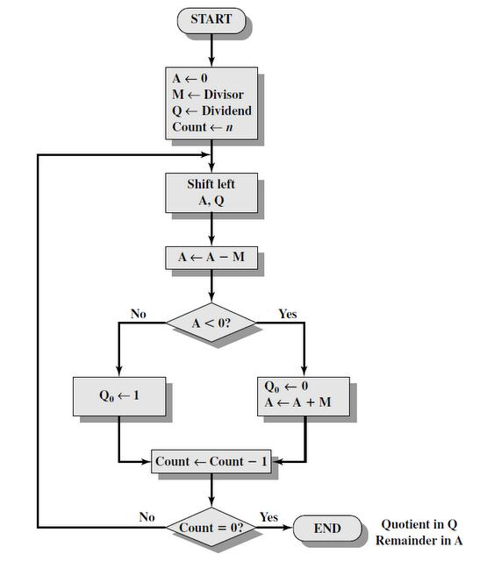
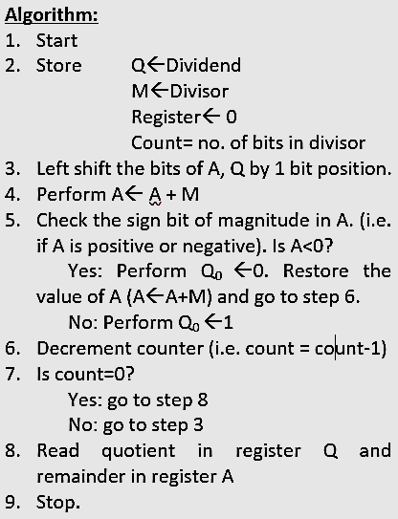
a) Unsigned Division
This is just for reference.
Do not follow this

Slide 41
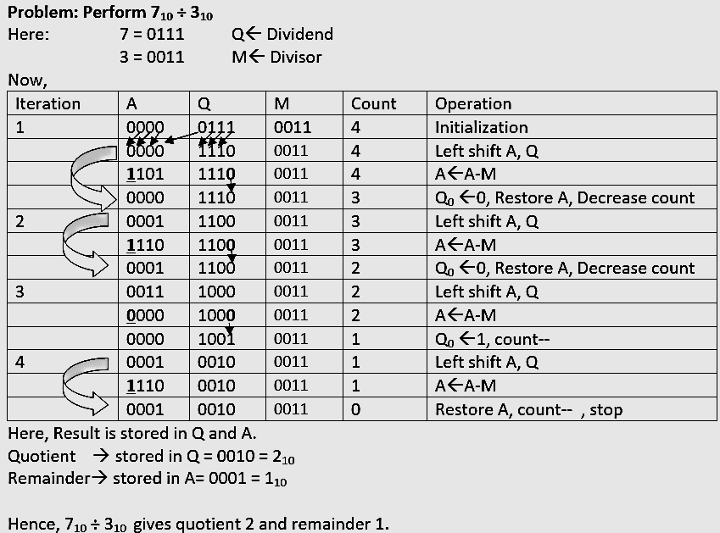
This is just for reference.
Do not follow this

Slide 42
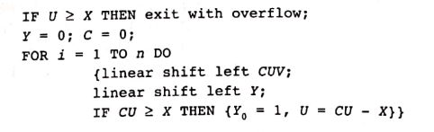
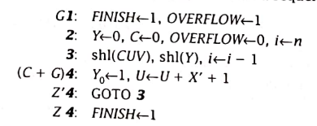
6.4 Division Algorithm
Division in Unsigned notation
Shift-Subtract Division Algorithm
RTL code
Algorithm
Assignment:
Construct the flowchart yourself.

Slide 43
Shift-Subtract Division
Algorithm
RTL code

Slide 44
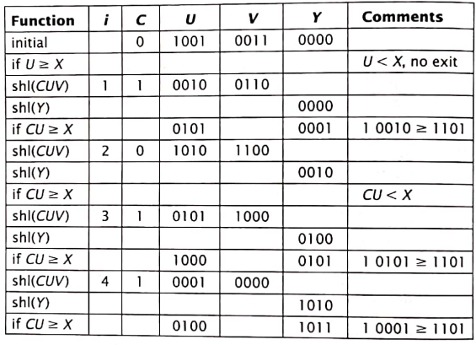
Division of 147/13 using Shift-Subtract Division Algorithm
Initially U=1001, V=0011
X=1101 and
N=4

Slide 45
RTL code to realize Shift-subtract Division Algorithm
In the following RTL code for this algorithm, X, U, V and Y are n-bit values and C and OVERLOW are 1-bit values.
As before Z=1 when i= 0.
For this algorithm, G=1 if U>=X.
FINISH is the same as on shift- add multiplication algorithm

Slide 46
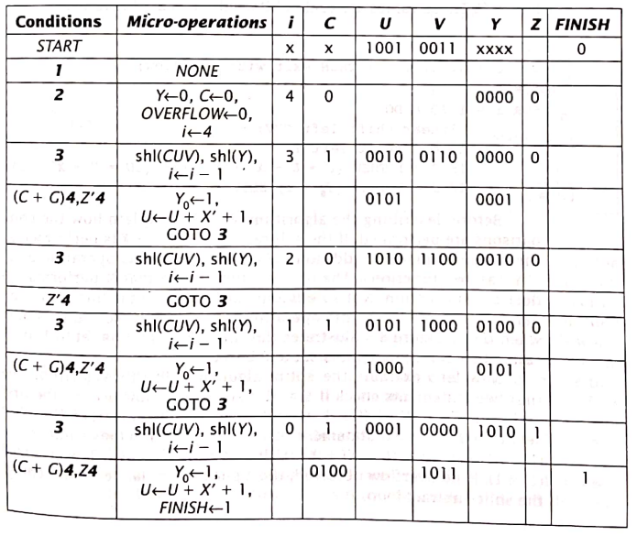
RTL code to realize Shift-subtract Division Algorithm
Remainder
Quotient

Slide 47
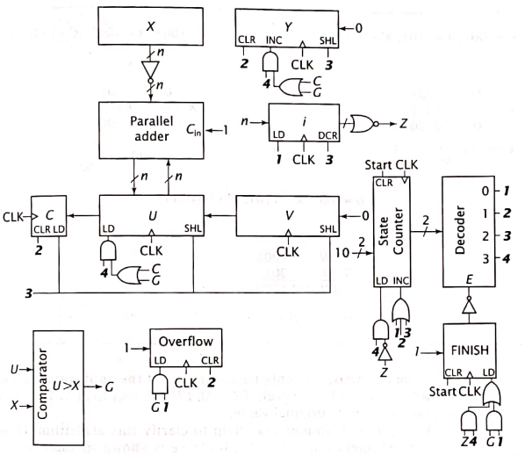
Hardware Implementation of Shift-Subtract Division Algorithm

Slide 48
Classwork:
Perform 14 ÷5

Slide 49
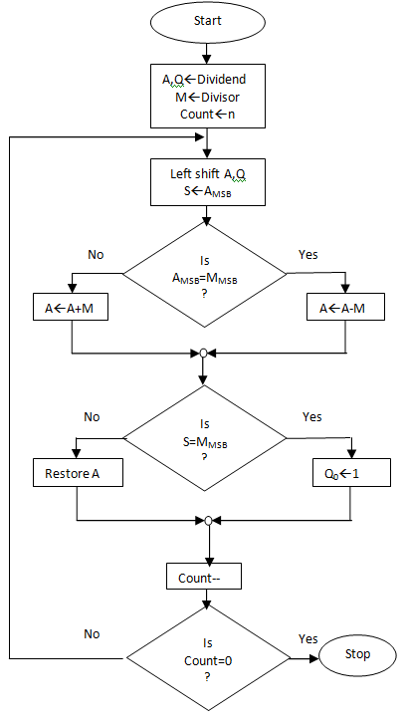
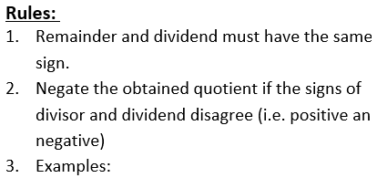
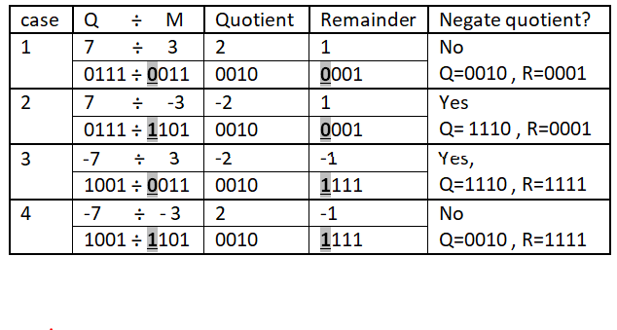
b) Signed Division
This is just for reference.
Do not follow this

Slide 50
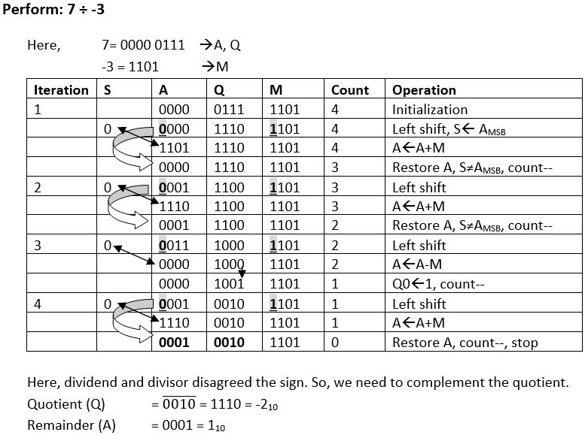
This is just for reference.
Do not follow this

Slide 51
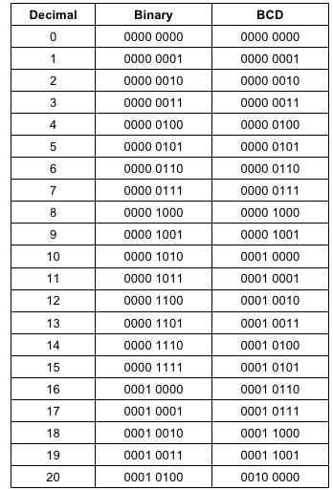
6.7 Binary Coded Decimal
It is the most popular format to represent decimal data
In BCD, each 4 bits represent one decimal digit.

Slide 52
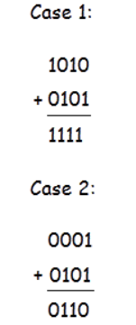
BCD Addition
Like other number system in BCD arithmetical operation may be required.
BCD is a numerical code which has several rules for addition.
The rules are given below in three steps with an example to make the idea of BCD Addition clear.
1. At first the given number are to be added using the rule of binary. For example,

Slide 53

BCD Addition
In second step we have to judge the result of addition. Here two cases are shown to describe the rules of BCD Addition. In case 1 the result of addition of two binary number is greater than 9, which is not valid for BCD number. But the result of addition in case 2 is less than 9, which is valid for BCD numbers.
If the four bit result of addition is greater than 9 and if a carry bit is present in the result then it is invalid and we have to add 6 whose binary equivalent is (0110)₂ to the result of addition. Then the resultant that we would get will be a valid binary coded number. In case 1 the result was (1111)₂, which is greater than 9 so we have to add 6 or (0110)₂ to it.

Slide 54
BCD Addition
As you can see the result is valid in BCD. But in case 2 the result was already valid BCD, so there is no need to add 6. This is how BCD Addition could be.
Now a question may arrive that why 6 is being added to the addition result in case BCD Addition instead of any other numbers. It is done to skip the six invalid states of binary coded decimal i.e from 10 to 15 and again return to the BCD codes.

Slide 55
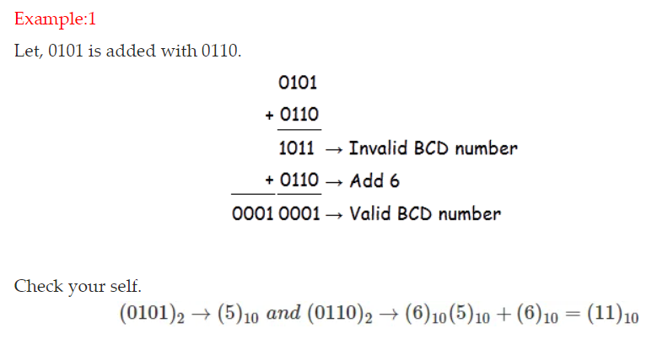
BCD Addition

Slide 56
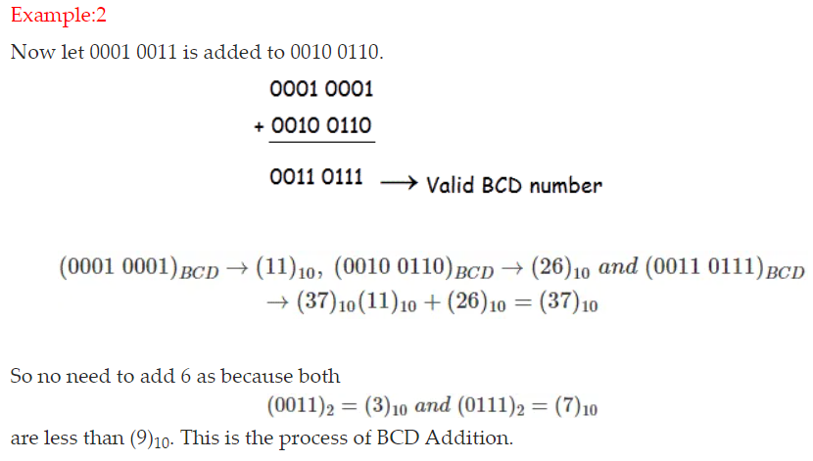
BCD Addition

Slide 57
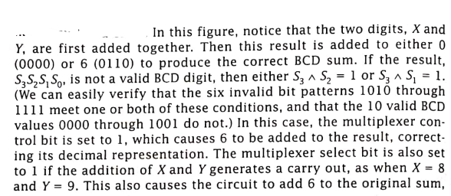
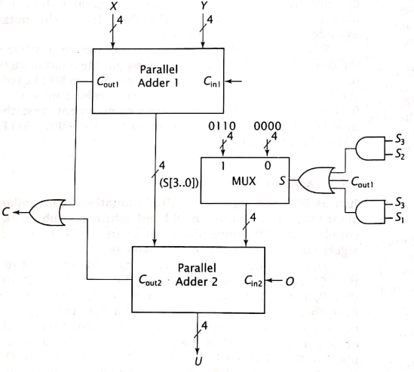
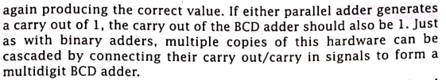
BCD Adder Hardware Implementation
Invalid BCD numbers
1010
1011
1100
1101
1110
1111

Slide 58
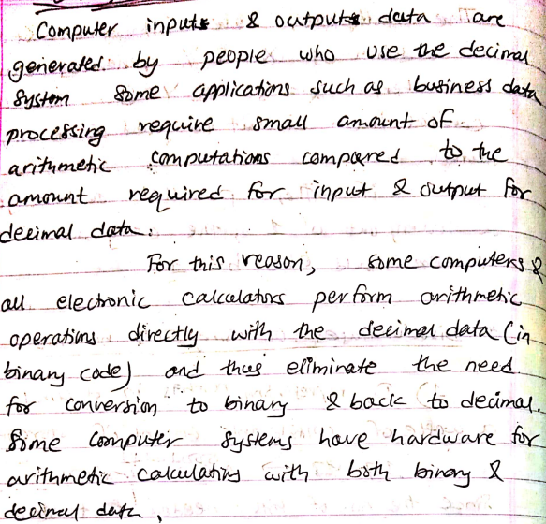
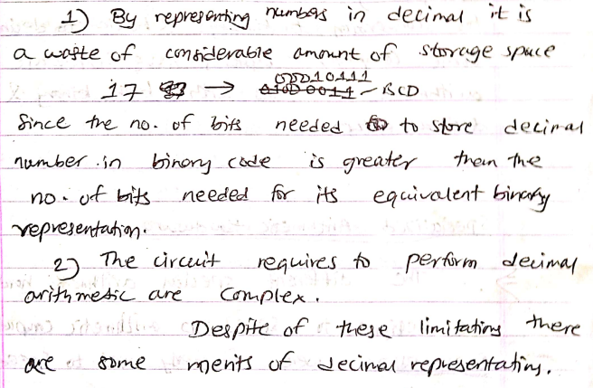
Advantages and Disadvantages of using BCD notations
Disadvantages:
Advantages:

Slide 59
6.8 Specialized Arithmetic Hardware
The different special arithmetic hardware are designed to speed up arithmetic computation.
Coprocessors were formerly used to speed up computations.
The coprocessor chip had specialized hardware that performed arithmetic calculations much more quickly than microprocessor.
Th coprocessor monitored instructions on system databus.
When the microprocessor fetched an instruction that the coprocessor could execute, the coprocessor sent a signal to microprocessor indicating that it would perform computation.
The coprocessor then calculates the result and send it to microprocessor.
If the coprocessor was not present, the microprocessor executes the instruction in slow way.

Slide 60
Specialized Arithmetic Hardware
Three techniques to improve speed of arithmetic calculation:
Pipelining
Look up Tables
Wallace Tree multipliers

Slide 61
1. Pipelining
An arithmetic pipeline is similar to an assembly line in a factory.
Data enters a stage of the pipeline, which performs some arithmetic operation on the data.
The results are then passed to the next stage, which performs its operations, and so on, until the final computation has been performed.
Each stage performs only its specific function.
It improves performance by overlapping computations; each stage can operate on different data simultaneously.

Slide 62
Pipelining example
Pipelining is a technique of decomposing a sequential process into sub-operations, with each subprocess being executed in a special dedicated segment that operates concurrently with all other segments.
The overlapping of computation is made possible by associating a register with each segment in the pipeline.
The registers provide isolation between each segment so that each can operate on distinct data simultaneously.
A clock is applied to all registers after enough time has elapsed to perform all segment activity.

Slide 63
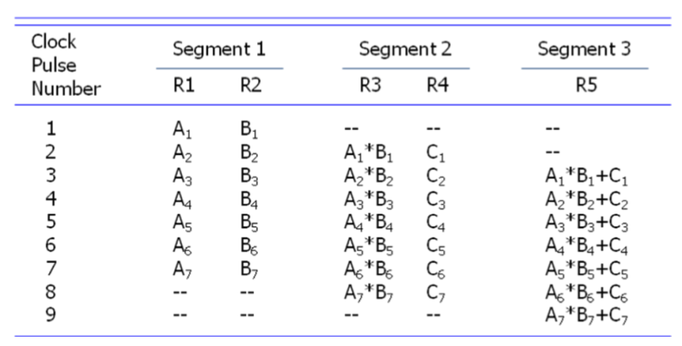

Pipelining example
Consider the below example: To perform the combined multiply and add operations with a stream of numbers A_{i} * B_{i} + C_{i} for i = 1, 2, 3, …, 7
Each sub-operation is to be implemented in a segment within a pipeline.
R1← A_{i}, R2← B_{i} Input A_{i} and B_{i}
R3 ← R1 * R2, R4 ← C_{i} Multiply and input C_{i}
R5 ← R3 + R4 Add C_{i} to product

Slide 64
2. Lookup Table
A combinational circuit can be implemented by a ROM configured as LookUp table.
The inputs to the combinational circuit serve as address inputs of the ROM.
The data outputs of ROM corresponds to the outputs of combinational circuit.
The ROM is programmed with data such that the correct values are output for any possible input values.

Slide 65

2. Lookup Table
Example: Let us consider 4 x 1 ROM programmed to mimic a two input AND gate.
The inputs to the AND gate serve as the address inputs to the ROM, and the output of the ROM corresponds to the AND gate output.
By programming the ROM with the data shown, it outputs the same values as the AND gate for all possible of X and Y.

Slide 66

A Multiplier implemented using a Lookup ROM
Recalling the shift-add multiplication algorithm for unsigned numbers, we can construct a hardware implementation for a multiplier using Lookup table.
UV←X.Y
Where U, V, X and Y are 4-bit registers.
Registers X and Y supply the address inputs to the lookup ROM. Its inputs are the product of X and Y, and are routed to registers U and V.
Each of the 256 locations must contain the 8-bit product of X and Y.
For example, location 1011 1101 contains the data 1000 1111 (i.e 143) , the product of 11 and 13.
Learn more from: https://hardwarebee.com/overview-of-lookup-tables-in-fpga-design/

Slide 67
Classwork
Design a Lookup ROM to implement the function f=xy + y’z.

Slide 68

3. Wallace Tree
A Wallace tree is a combinational circuit used to multiply two numbers. It requires more hardware but can produce a product in less time.
It requires carry save adders and only one parallel adder.
A carry-save adder can add 3 values simultaneously instead of just two. It outputs both sum and a set of carry bits.
This is illustrated below:

Slide 69
Wallace Tree
Each bit S_{i} is the binary sum of bits X_{i}, Y_{i} and Z_{i}
Carry bit C_{i+1} is the carry generated by this sum.
To form a final sum, C and S must be added together.
Because carry bits do not propagate through the adder, it is faster than a parallel adder.

Slide 70

An example of addition for three numbers : 7+11+2
Adding S and C using a parallel adder, it produces the result 10100 (20) which is by 00110+1110 =10100.
C₃ C₂ C₁ C₀

Slide 71

Wallace Tree
To use a carry-save adder to perform multiplication we first calculate the partial products (PP) of the multiplication, then input them to the carry-save adder.
Consider a numeric example multiplication of 7x6.

Slide 72


A 3x3 Wallace Tree Multiplier
1 1 1
1 1 0

Slide 73
6.9 Floating Point Numbers
The floating point representation of a number has two parts.
The first part represent a signed fixed point number called mantissa.
The second part designates the position of decimal (or binary) point and is called exponent.
The fixed point mantissa may be fraction or an integer.
For example:
The decimal number 6132.789 is represented in floating point as 0.6132789 x 10⁴
This is in the form: m x r^{e}
where
m is mantissa and
e is exponent.
The value of exponent indicates that actual position of decimal point is four position to right of indicate decimal point in fraction
Fraction | Exponent
0.6132789 | 04

Slide 74
6.9 Floating Point Numbers
For example a decimal number 3.25₁₀= 11.01₂
^{= 1.101}₂ ^{x10}₂
_{=1.101 x 2}¹
Fraction | Exponent
1.101 | 01

Slide 75
6.10 IEEE 754 floating Point Standard, Numeric Format
The IEEE Standard for Floating-Point Arithmetic (IEEE 754) is a technical standard for floating-point computation which was established in 1985 by the Institute of Electrical and Electronics Engineers (IEEE).
The standard addressed many problems found in the diverse floating point implementations that made them difficult to use reliably and reduced their portability.
IEEE Standard 754 floating point is the most common representation today for real numbers on computers, including Intel-based PC’s, Macs, and most Unix platforms.
There are several ways to represent floating point number but IEEE 754 is the most efficient in most cases.

Slide 76
6.10 IEEE 754 floating Point Standard, Numeric Format
There are several ways to represent floating point number but IEEE 754 is the most efficient in most cases.
IEEE 754 has 3 basic components:
The Sign of Mantissa – This is as simple as the name. 0 represents a positive number while 1 represents a negative number.
The Biased exponent – The exponent field needs to represent both positive and negative exponents. A bias is added to the actual exponent in order to get the stored exponent.
The Normalised Mantisa – The mantissa is part of a number in scientific notation or a floating-point number, consisting of its significant digits. Here we have only 2 digits, i.e. O and 1. So a normalised mantissa is one with only one 1 to the left of the decimal.

Slide 77

6.10 IEEE 754 floating Point Standard, Numeric Format
IEEE 754 numbers are divided into two based on the above three components: single precision and double precision.

Slide 78
Denormalization
Denormalize: 1.101 x2¹
Here: exponent of base 2 =1
Bias=127
E=127+1 =128
Hence the denormalized encoding of 1.101 x2¹ is:
Sign | Exponent | Significant no (fractional no)
0 | 1000 0000 | 101 0000 0000 0000 0000 0000
1 bit | 8 bits | 23 bits
Reference: https://www.youtube.com/watch?v=T_Wxrp-2DZQ

Slide 79
Represent (1259.125)₁₀ in single precision format
Step 1: Convert decimal number to binary number
^{1259.125}₁₀ ^{= 10011101011.001}₂
Step 2: Normalize the number in the form: (1.N )2^{E-127}
10011101011.001₂ = 1.0011101011001 x 2 ¹⁰
Here: exponent of base 2 =10
Bias=127
E=127+10 =137 =10001001
Hence the denormalized encoding of 1.0011101011001 x2¹⁰⁰⁰¹⁰⁰¹ is:
Sign | Exponent | Significant no (fractional no)
0 | 1000 1001 | 001 1101 0110 0100 0000 0000
1 bit | 8 bits | 23 bits
Reference: https://www.youtube.com/watch?v=T_Wxrp-2DZQ

Slide 80
Normalization
Sign | Exponent | Significant no (fractional no)
1 | 1000 0000 | 101 0000 0000 0000 0000 0000
1 bit | 8 bits | 23 bits
Here, sign bit =1 Hence, the no. Is negative
Exponent =1000 0000
So, E=128-127 =1
Also, S=101 0000 0000 0000 0000 0000
=1.101
Therefore, binary no is: = -1.101 x 2¹
=-1.101 x 10
=-11.01₂

Slide 81
Floating point Addition/Subtraction
Let
X= ± X_{S} + B ^{± XE}
Y= ± Y_{S} + B ^{± YE}
For X_{E} = Y_{E} ,
Addition | X+Y= (X_{S} + Y_{S} ) x B ^{XE}
Subtraction | X-Y= (X_{S} - Y_{S} ) x B ^{XE}
Multiplication | X*Y= (X_{S}*Y_{S} ) x B ^{XE + YE}
Division | X÷Y= (X_{S} ÷Y_{S} ) x B ^{XE -YE}

Slide 82
Given two fractional no: X= 0.3 x 10² Y= 3.0 x 10² Perform addition.
Solution:
Here, X_{S}=0.3 B^{XE}=10²
Y_{S}=3.0 B^{YE}=10²
Now,
X+Y = (X_{S} + Y_{S}) x B^{XE}
= (0.3 +3.0) x 10²
=3.3 x 10²

Slide 83
Perform addition for the given binary floating numbers. And also normalize the result. X=-1.01 x 2² Y=1.1 x 2⁴
Solution:
X = -1.01 x 2² Y = 1.1 x 2⁴
= -0.0101 x 2⁴ = 1.1 x 2⁴
Here,
X+Y = (X_{S}+Y_{S}) x B^{XE}
=(-0.0101 +1.1) X 2⁴
=1.0011X 2⁴
Now to normalize for 1.0011 x 2⁴
Exponent of base 2 =4
Bias = 127 for 8 bit
E =127 + 4 = 131
Hence, normalized encoding of 1.0011 x 2⁴ is:
0 | 1000 1000 | 0011 0000 0000 0000 0000 0000

Slide 84
Assignment:
Trace the multiplication of -9 and -12 using RTL code of Booth’s algorithm. Also verify the obtained product.
Write RTL code for Booth’s algorithm. Trace the multiplication of 7 and -4 using RTL code of Booth’s algorithm. Also verify the obtained product.
Show the Wallace tree to perform 4x4 multiplication for 1101 x1110.
Describe about BCD addition.
What is Lookup ROM? Describe in brief demonstrating a Lookup ROM working as XOR gate.
Show the memory content of a Lookup ROM equivalent to input OR gate.
Design a Lookup ROM to implement the function f=xy + y+z.
Design a Lookup ROM to implement the function f=xyz + yz.

Slide 85
Exam Questions:
Trace the multiplication of (4) and (3) using RTL code of shift Add Multiplication Algorithm. [PU 2017 Fall]
Write the RTL code for Booth’s Algorithm. Show the hardware implementation for the RTL code. [PU 2017 Fall]
What is Wallace Tree? Describe in brief demonstrating a 3x3 multiplier being constructed using Wallace tree and carry save adder. [PU 2017 Fall]
What is Lookup ROM? Show the memory content of a Lookup ROM equivalent to input OR gate. [PU 2017 Spring]
Write the RTL code for Shift Add Algorithm. Show the hardware implementation for the RTL code. [PU 2017 Spring]
What is Arithmetic Pipelining? Describe in brief with an example. [PU 2017 Spring]
List out the RTL code for arithmetic and logical operations. Also show the implantation of addition and subtraction using parallel adder. [PU 2018 Fall]
Write down the RTL code for Booth’s Algorithm. [PU 2018 Fall]
What is Lookup ROM? Describe in brief demonstrating a Lookup ROM working as XOR gate. [PU 2018 Fall]
Trace RTL code of shift add multiplication algorithm for multiplication of 3 and 4. [PU 2018 Spring]

Slide 86
Exam Questions:
What is Lookup ROM? Illustrate with an example how it works? [PU 2018 Spring]
Trace RTL code for Booth’s Algorithm for multiplication of 9 and -3. [PU 2019 Spring]
What is Lookup ROM? Design a Lookup ROM to implement the function f=xy + y’z. [PU 2019 Spring]
Perform -7 x -2 using booth’s algorithm. Can booths algorithm be used if both numbers are positive, if yes how? [PU 2020 Spring]
Write short notes on:
Signed and Unsigned Number representation. [PU 2017 Spring]
BCD addition [PU 2018 Fall]
BCD adder [PU 2018 Spring]

Slide 87
End of Chapter

